Slide 1
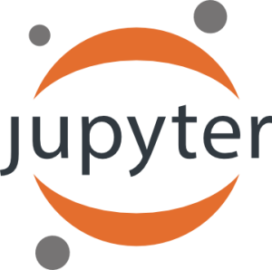
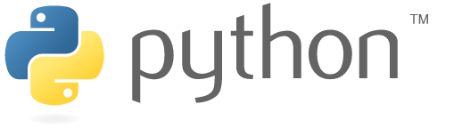
Introduction to Python
- Part I -
Raden Muhammad Hadi

Slide 2
What is Python
Why Python
Begining Python
  Python 2.7 and Python 3
  Interactive Shell, IDE and ICE
  Let’s Code!

Slide 3
Python Is ...
High-level programming language
Open source and community driven
Dynamic typed
Run just-in-time

Slide 4


public class HelloWorld {
public static void main(String[] args) {
System.out.println("Hello, World");
}
}
Java
Python
Print(“Hello, World!”)

Slide 5
Use Python Because ...
It’s easy to learn
Jack-Of-All-Trade
A lot of module/library/package to use
Increasingly popular

Slide 6
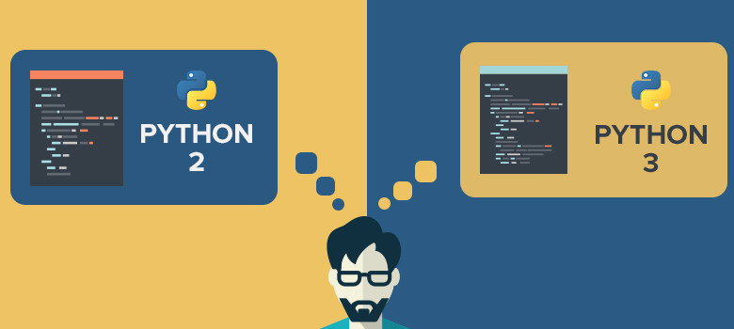
Python 2.x or Python 3.x?

Slide 7
Difference Between Python 2.x & Python 3.x
Python 2.x | Python 3.x
print “Hello, World!” | print(“Hello, Wolrd!”)
3/2 = 1 | 3/2 = 1.5
print range(3) [0,1,2] | print(range(3)) range(0, 3)

Slide 8
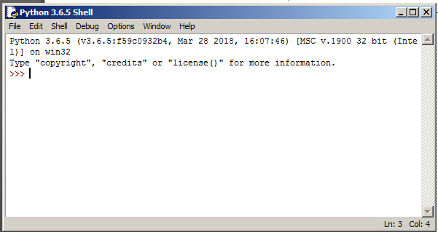
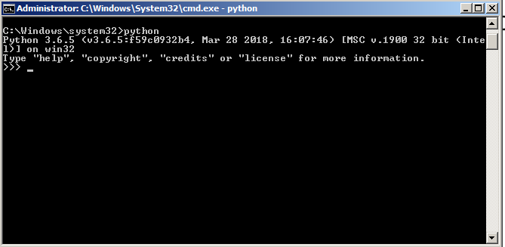
Python Shell: The Playground
Great for learning and experimenting with Python.
Lack autocomplete

Slide 9
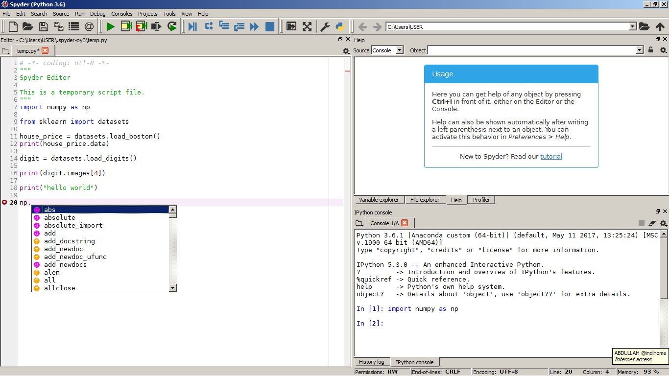
Spyder: Advanced IDE for Python
Bigger playground
+
autocomplete

Slide 10
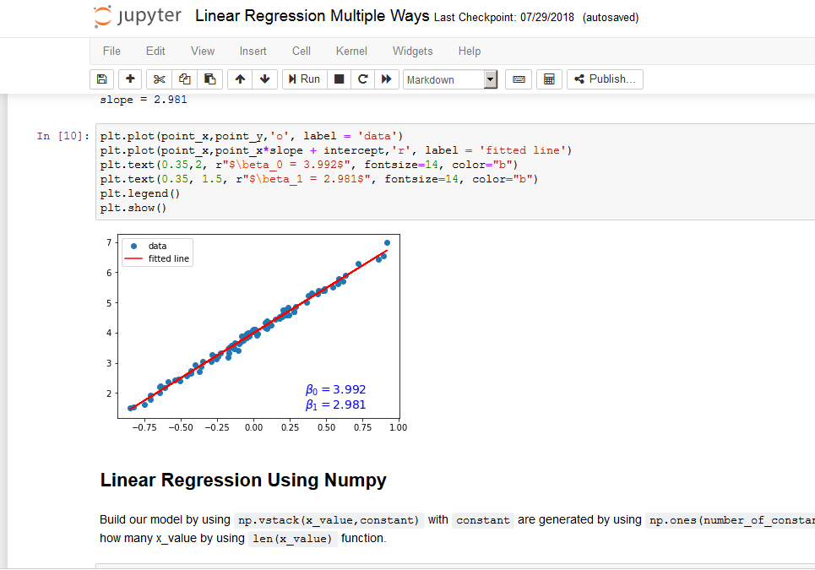
Jupyter: Interactive Computing Environment
Great for sharing research;
Build simple dashboard app;
Autocomplete

Slide 11

Let’s Code!

